Slide 1
Quest 4
Samuel Kraft, Joshua Arrevillaga, Michael Barany

Slide 2
Project Overview
Objective: Develop a system for ESP32 nodes to dynamically elect a leader, forward messages via hybrid Infrared (IR) and UDP communication, and ensure reliable data propagation.
Key Features:
Leader Election: Bully Algorithm for dynamic leader selection.
Hybrid Communication: Infrared for local messaging, UDP for inter-node and server communication.
State Management: Tracks states (Uncertain, Leader, Follower) and ensures fault tolerance.
Hardware Setup:
ESP32 boards with IR transmitter, receiver, Wi-Fi module, LEDs, and a button.
Central server for message aggregation.
Outcome: A robust system demonstrating seamless hybrid communication, efficient leader election, and fault recovery.

Slide 3
Logic
Workflow:
Startup:
Each ESP32 initializes its ID and state as "Uncertain."
Broadcasts an election message via UDP to other nodes.
Leader Election (Bully Algorithm):
Nodes with higher IDs respond with an "Election" message.
Node with the highest ID declares itself as the leader and sends a "Victory" message to all nodes.
All other nodes transition to the "Follower" state.
Message Flow:
Infrared (IR) messages are validated using checksums and forwarded to the leader via UDP.
Leader aggregates and forwards messages to the central server using a fixed IP and port.
Fault Recovery:
Leader sends periodic heartbeats via UDP.
Followers monitor heartbeats; on timeout, a new election is triggered.
Confirmation Mechanism:
Nodes send confirmation back to the sender upon processing received IR messages.
Control Flow:
State Transitions:
Uncertain → Leader: On winning the election.
Uncertain → Follower: On receiving a higher-ID node's "Victory" message.
Follower → Uncertain: On heartbeat timeout.
Communication Flow:
IR → Local Message Validation → UDP Forwarding → Leader Aggregation → Server Delivery.
Data Flow Diagram:
Infrared:
Button press → Generate message → Send via UART (IR TX).
Receive via UART (IR RX) → Validate checksum → Forward.
UDP:
Validated messages → Socket communication → Leader/Server.
Heartbeats and election messages → Broadcast to all nodes.

Slide 4
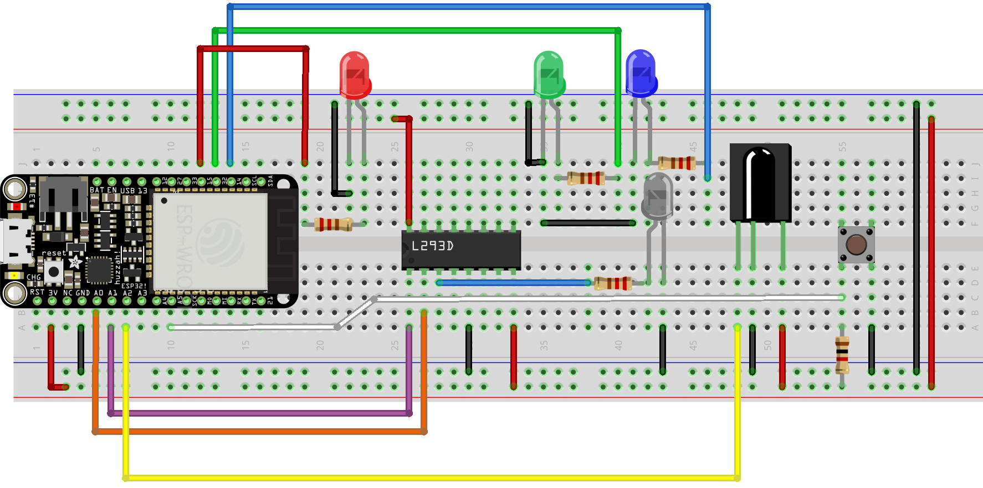
Circuit used for fobs

Slide 5
Reflections
We should plan out our quest timeline better
get the skills done early so the quest won’t be as tedious to do later on
Ask for help when we need it

